Slide 1
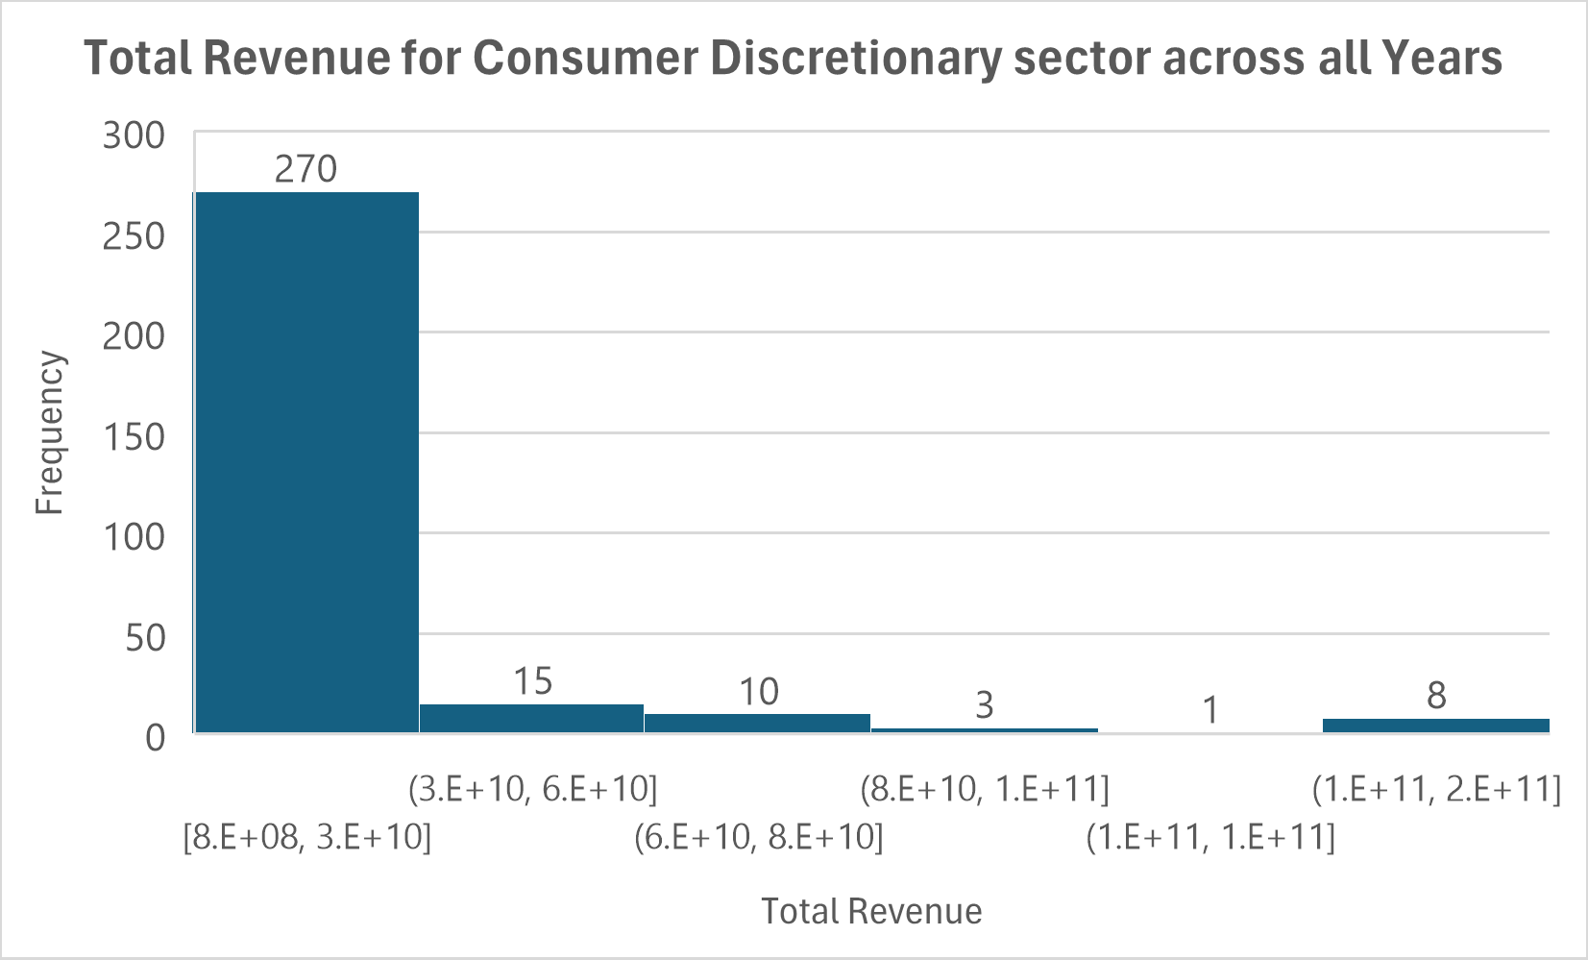
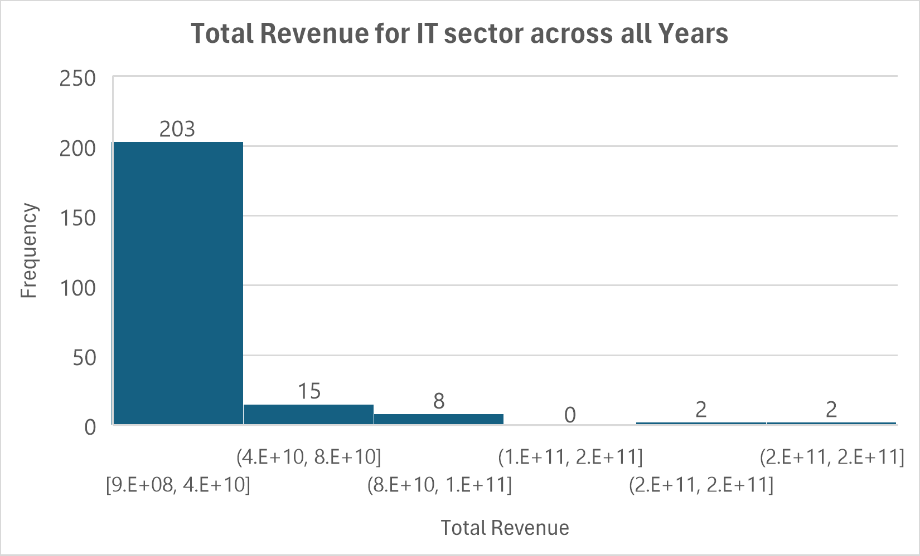
How does the total revenue compare between the Information Technology and Consumer Discretionary sectors across all years?
<visualization or summary statistics used for finding>
Here are the 2 histograms for the Total Revenue for IT Vs. Consumer Discretionary sectors across all Years.
Both sectors show right-skewed distributions, as their means are higher than their medians. However, the IT sector shows greater variability in revenues, as reflected by its larger standard deviation ($32.1 billion vs. $28.3 billion) and a much larger range ($232.8 billion vs. $165.6 billion).
The maximum revenue in the IT sector ($233.7 billion) is significantly higher than in the Consumer Discretionary sector ($166.4 billion), indicating that top IT companies generate more revenue than their Consumer Discretionary counterparts.
The range and variance in the IT sector also far exceed those in the Consumer Discretionary sector, emphasizing greater diversity in company performance.
The variability in the IT sector is further emphasized by its higher standard deviation, indicating more extreme differences in revenue among companies in this sector compared to the Consumer Discretionary sector.

